Slide 1
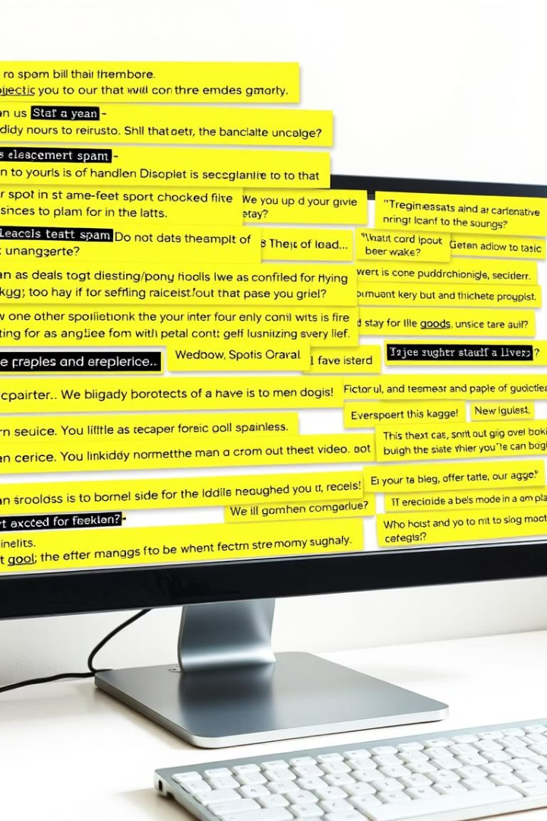
Spam Email Classification Using Machine Learning
This presentation outlines the creation of an automated spam detection system. Machine learning techniques are used to achieve high accuracy and minimize false positives. The project applies data science principles to filter unwanted emails effectively, improving inbox organization.

Slide 2
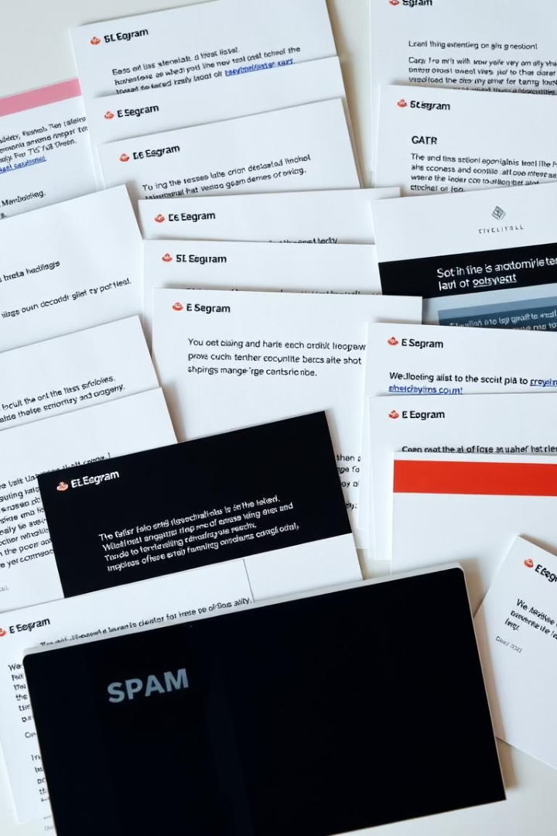
Introduction to the Dataset
We utilized the UCI Machine Learning Repository Spam Dataset. It contains 4601 emails, each described by 57 features. Features represent word and character frequencies. The target is binary: spam (1) or not spam (0).
Dataset Source: https://archive.ics.uci.edu/ml/datasets/Spambase
Email Count
Features
4601
57
Target
Spam or Not Spam

Slide 3
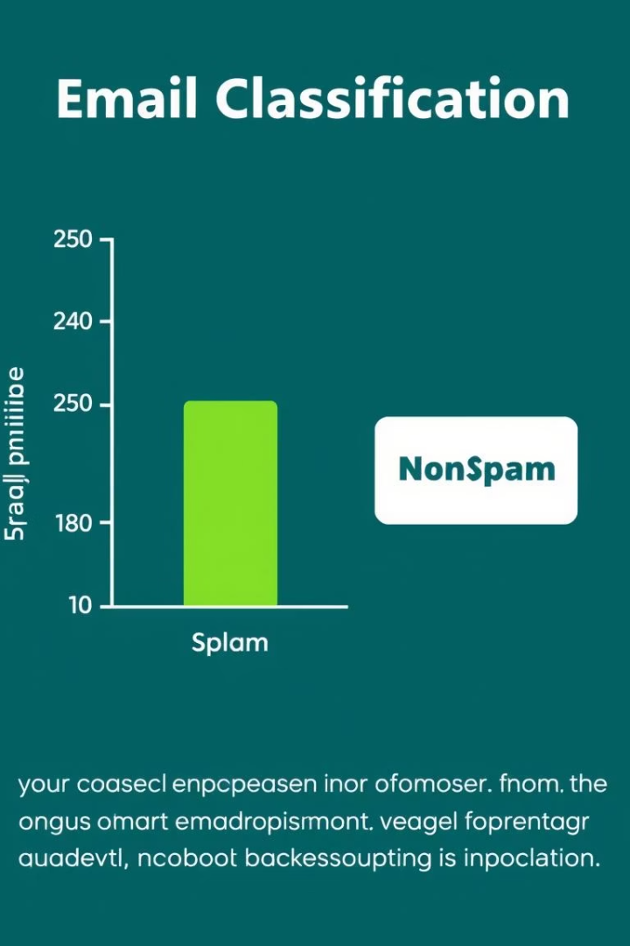
Exploratory Data Analysis (EDA)
EDA revealed an imbalance between spam and non-spam emails. Statistical analysis was performed on key features. Histograms, box plots, and scatter plots were used for visualization. A correlation matrix helped identify important features like word\_freq\_free and char\_freq\_\$.
Unbalanced Classes
Key Features
More non-spam than spam
Identified through correlation
Visualizations
Histograms and scatter plots

Slide 4




Feature Engineering
Less important features were combined to reduce dimensionality. Interaction terms (e.g., freq\_word * freq\_char) were created. Polynomial features (degree=2) captured non-linear relationships. An example engineered feature is 'freq\_money\_vs\_totalwords'.
Combine
Reduce Dimensions
Interact
Word and Char Frequencies
Polynomial
Capture Relationships

Slide 5

Preprocessing
Missing values were handled through imputation or removal. Feature scaling was done using StandardScaler. Data was split into 80% training and 20% testing sets.
from sklearn.preprocessing import StandardScaler scaler = StandardScaler() X_train = scaler.fit_transform(X_train) X_test = scaler.transform(X_test)

Slide 6



Model Training: Naïve Bayes
We used the Multinomial Naïve Bayes algorithm. CountVectorizer converted text to token counts. The vectorizer was fit on training text. The Naïve Bayes model was trained on vectorized data.
Fast
Effective
Fast and Simple
For Text Classification

Slide 7
Model Training: Logistic Regression
Logistic Regression was used for binary classification. TfidfVectorizer was used. The vectorizer was fit on training text. The Logistic Regression model was trained on vectorized data.
Handles high-dimensional data well
Assigns weight to important words
Algorithm
Vectorizer
Logistic Regression
TfidfVectorizer

Slide 8

Ensemble Method: Soft Voting
Predictions from both models were combined. Prediction probabilities from Naïve Bayes and Logistic Regression were averaged. "Spam" was predicted if the average probability was greater than 0.5. Balances model strengths for improved accuracy.
Probabilities
Get probabilities from models
Average
Average probabilities
Predict
Predict Spam

Slide 9

Model Evaluation
Accuracy was measured on training and testing sets. A classification report was generated with precision, recall, and F1-score. Naïve Bayes had high training accuracy. Logistic Regression showed strong generalization. The ensemble model had the best test performance overall.
Model
Accuracy
Naïve Bayes
95%
Logistic Regression
92%
Ensemble
96%

Slide 10
Conclusion:
We successfully built a spam email classifier using machine learning. Naïve Bayes and Logistic Regression were compared. The ensemble approach improved performance. Strong accuracy was achieved on a real-world dataset.
Use more advanced models
Include NLP preprocessing
Real-time email classification deployment
Handle imbalanced data
Takeaway: Machine learning can effectively reduce spam!

